Slide 1
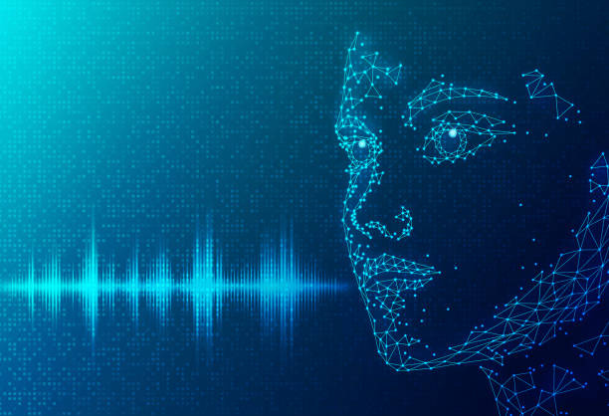
Multilingual voice control of automotive equipment's
"The Ultimate Idea of Communication"

Slide 2
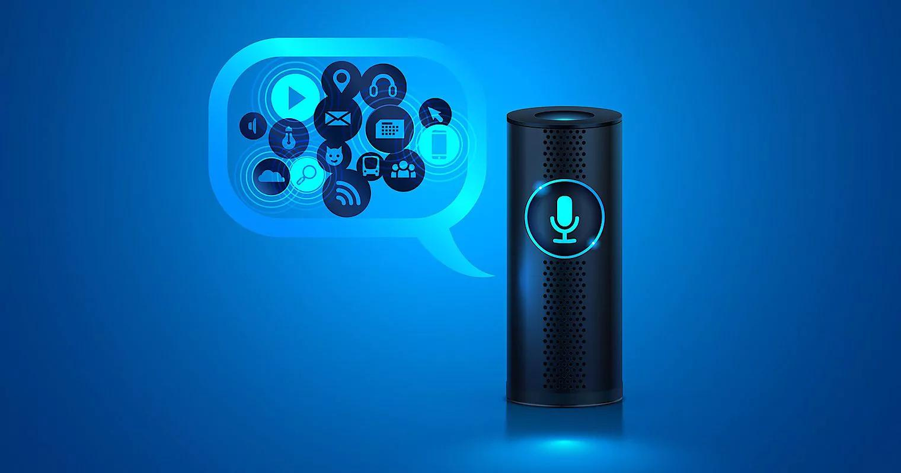
Introduction
Using the native language to
operate machines is quite
interesting, compared to using
English language. It can be
challenging to instruct a machine
in English or any other language .
Our model helps in directly interacting with the
machine in your native language in order to solve this
problem. Here, we are using a car that can be operated in
either its native tongue or in any language. Car function like requesting
specific routes, controlling media, adjusting climate, and managing other
functions – all through natural language interaction..

Slide 3

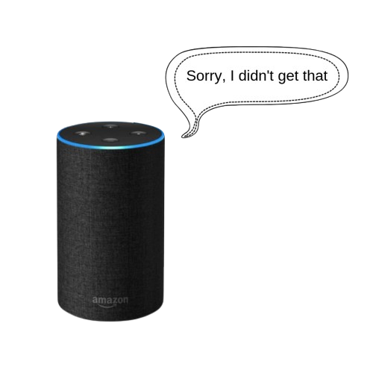
Problem Description
Voice controlled tools are now acquiring each and every aspect of human life. From simplest application like mobiles to the complex computer everything is now controlled by voice.
One of the main applications of these is seen in the automobiles. Voice assistant are now made a part of the automobile which will give the user a next level experience while roaming through it.
But the main problem with those tools is that they are not supporting many languages. User have to interact with the tools in English language mostly. Also, the commands should be proper and clear otherwise the output won’t be generated as per the need.
The local drivers or the common people face the problem while using those tools, because they do not support the multilingual facility.

Slide 4
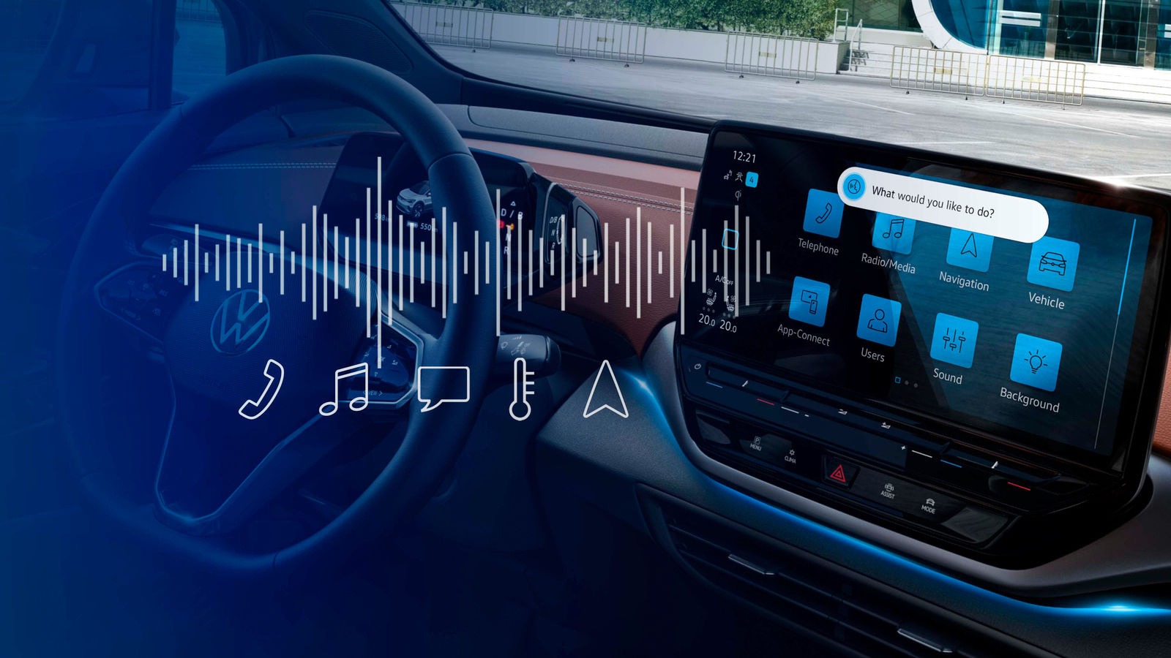
Problem
Statement
______________
Design and develop a multilingual voice control of automotive equipments. Develop a tool which will accept the voice as an input through a voice receiver. Process the input according to the language and then will generate output or complete the tasks according to the command.

Slide 5
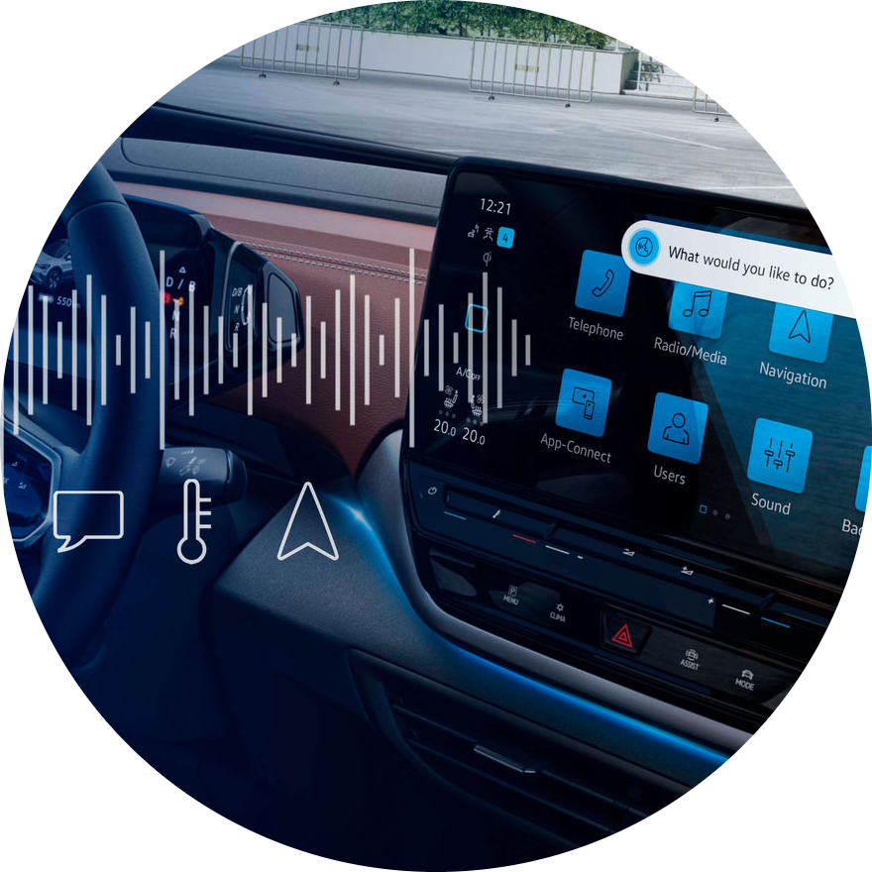
Objectives
Develop a reliable multilingual voice recognition system that can understand instructions correctly in a variety of languages that drivers and passengers frequently speak.
Implement a user-friendly experience in the system which will allow user to interact with it more often.
To verify the system's dependability, correctness, and safety in a variety of language situations, carry out rigorous testing and validation.

Slide 6
Methodology
User
Microphone
Speaker
speech to text converter
Language Processing Block
Text to speech converter
Command Generator
Command Generator
Command Processing Unit
Automobile
Web Server

Slide 7

Laptop/PC with minimum 4gb ram
Prototype automobile
Facility Required
Microphone / Speaker / DC & Servo Motors
Raspberrypi 4b / L298 Motor Driver

Slide 8
Advantages
Our project's primary benefit is its ability to handle numerous languages at once. While the existing solutions on the market only support English, ours can support numerous languages simultaneously. while existing solutions mostly address software, ours will address both the hardware and software components. Our idea is unique in that it uses voice control to operate simple hardware.
Enhanced Accessibility: Enables users to interact with the vehicle's amenities in their preferred language, accommodating a diverse user base.
Reduced manual controls: Minimizes the need for manual controls, enhancing safety by keeping drivers focused on the road.

Slide 9
Disadvantages
Complex Integration: Integrating multilingual voice control can be technically challenging, potentially requiring significant development resources and expertise.
Potential Confusion: Users might find it confusing if only a subset of functions can be controlled through voice, leading to a disjointed user experience

Slide 10
Use-Case
Utility
Enhanced User Experience
Accessibility
Global Market
Future Proofing
Economic Sustainability
Revenue Streams
Cost Efficiency
Market Penetration
Monetization
Scalability
Market Potential
Segmentation
Target Users/Customers
Competitive Advantage
Sustainability
Energy Efficiency
Extended Lifespan

Slide 11
Conclusion
_____________
The project aims to create a multilingual voice control system which will help its user to give command in any language and then perform the task accordingly. We aim to remove the main problem of language barrier while operating with voice assisted tools. It will help the native speaker to get the benefit of such tools effortlessly.

Slide 12
Thank You

